Slide 1
DrawingBoard PPT Addin
Business Analysis Basics

Slide 2
Business Stakeholders
Customer
Distributors
Competitors
Service
Providers
Suppliers

Slide 3
Project Management Icons
RELATIVE IMPORTANCE
RELATIVE IMPORTANCE
<Item>
<Item>
<Item>
<Item>
<label>
<Item>
<Item>
<Item>
<Item>
<Item>
Stage 5
<Item>
<Item>
<Item>
<Item>
Stage 4
<label>
<Item>
<Item>
<Item>
Stage 3
Stage 2
Innovation Based
Planning
Stage 1
Strategy
Based
Planning
Industry Benchmark Based Planning
Budget Based Planning
Forecast Based Planning
Increasing Business Maturity

Slide 4
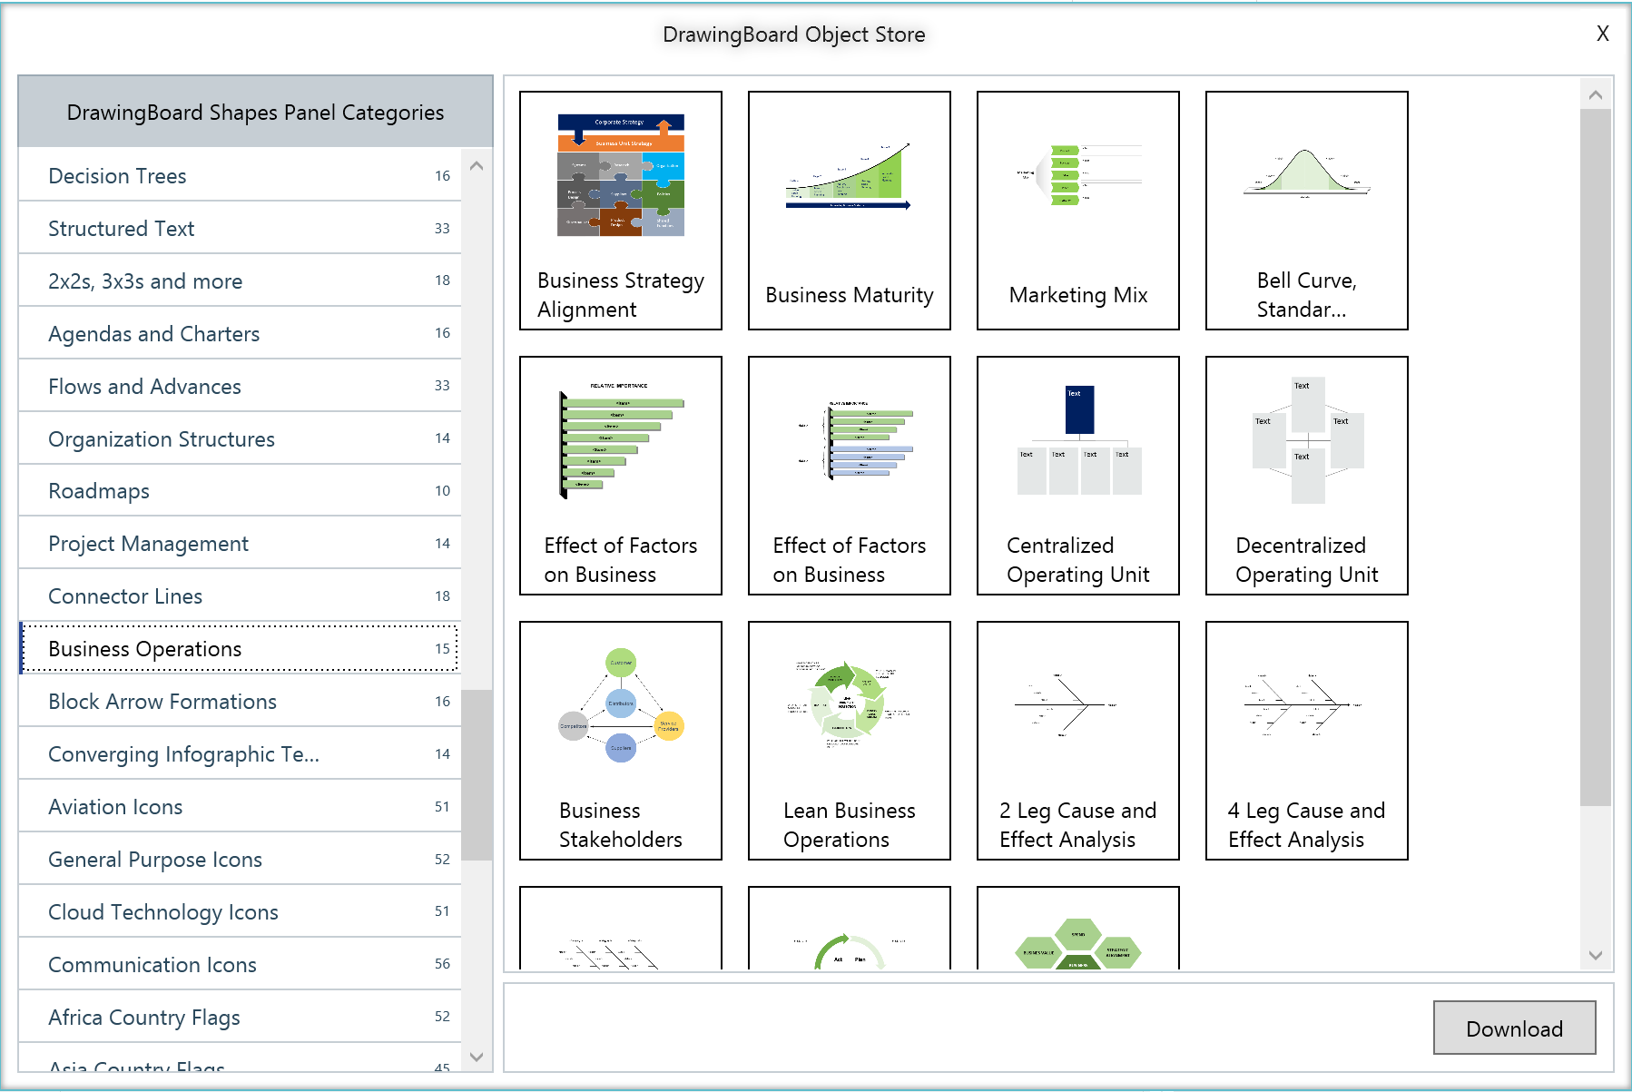
Choose from 100s of categories in Object Store
Dozens of icons related to various aspects of business
Business Operations
Download in 1 click
Watch Video: https://www.next2office.com/Tutorials.aspx

Slide 5
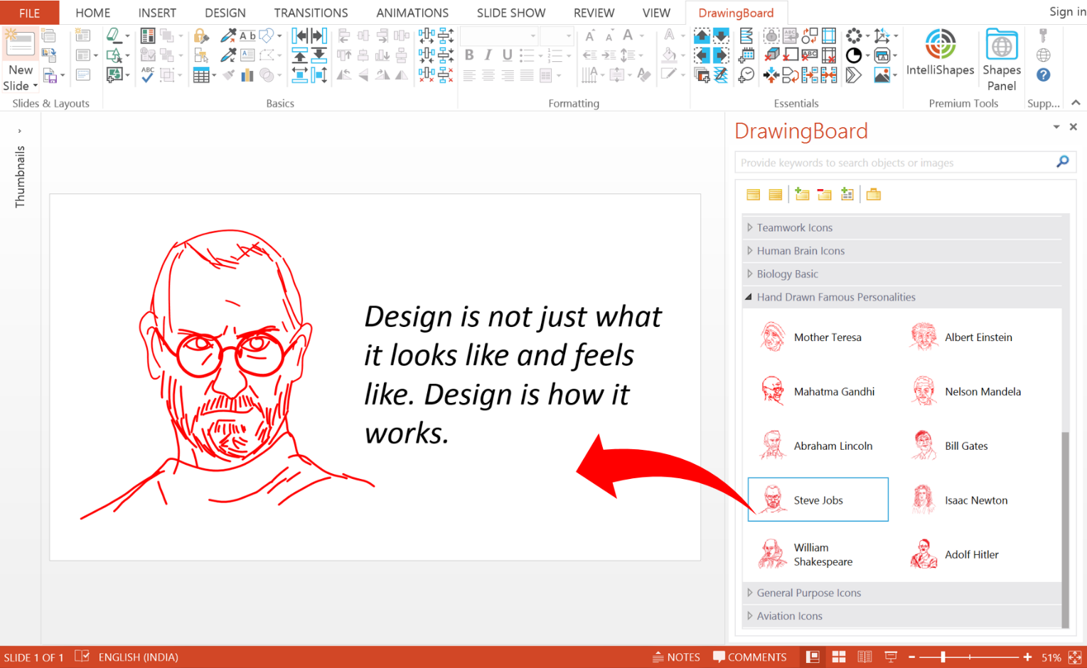
The power of DrawingBoard’s Shapes Panel
Smart Search Feature
Objects organized into category for meaningful classification
Objects displayed as icons with names and description
Drag and Drop action to insert the object into your slide
Watch Video: https://www.next2office.com/Tutorials.aspx

