Slide 1
DrawingBoard PPT Addin
Cool Circular Objects

Slide 2
5 Features Highlights
Label
Text
Label
Label
Text
Title
Text
Label
Label
Text
Text

Slide 3
6 and 7 Features Highlights
Label
Label
Label
Text
Label
Label
Text
Label
Text
Text
Text
Text
Title
Title
Label
Label
Label
Label
Text
Text
Text
Label
Text
Label
Label
Text
Text
Text

Slide 4
More Circular Shapes
Sample text here
Sample text here
04
Sample text here
Sample text here
05
06
01
Sample text here
Sample text here
01
Sample text here
01
04
Sample text here
05
02
03
02
Sample text here
Sample text here
Sample text here
04
03
Sample text here
Sample text here
03
02
Sample text here
Sample text here

Slide 5
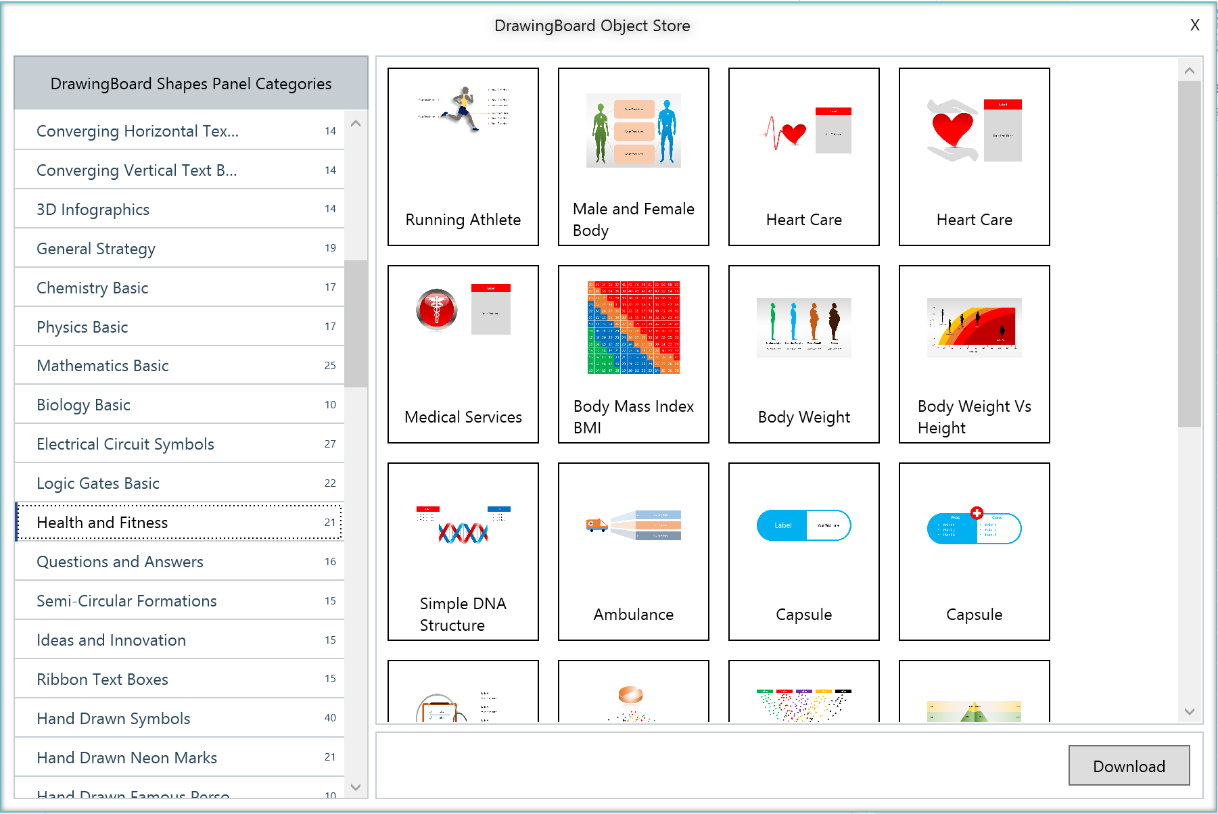
Choose from 100s of categories in Object Store
Health and fitness related ppt objects
Progress Meters
Download in 1 click
Watch Video: https://www.next2office.com/Tutorials.aspx

Slide 6
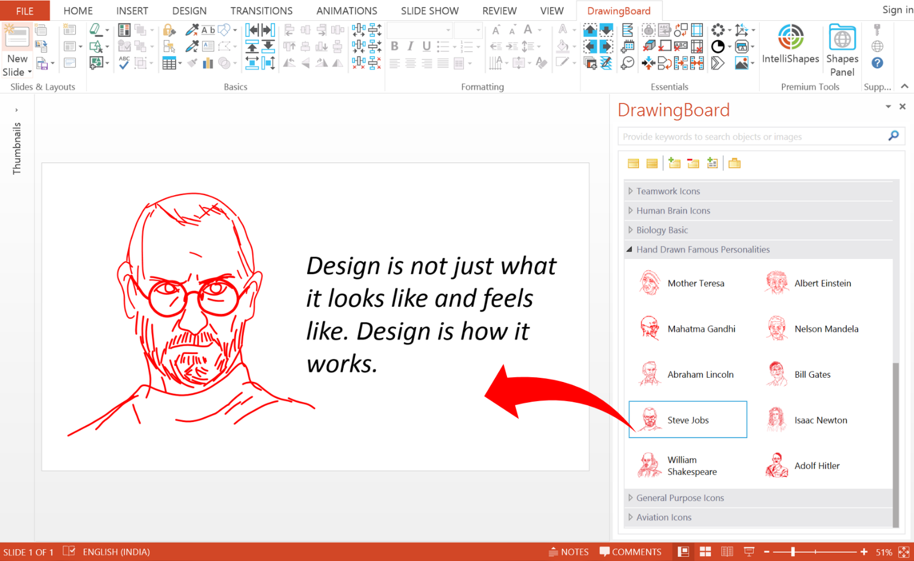
The power of DrawingBoard’s Shapes Panel
Smart Search Feature
Objects organized into category for meaningful classification
Objects displayed as icons with names and description
Drag and Drop action to insert the object into your slide
Watch Video: https://www.next2office.com/Tutorials.aspx

