Slide 1
DrawingBoard PPT Addin
Project Status and More

Slide 2
Project Management
Jan
Feb
Mar
Apr
May
Jun
July
Aug
Sept
Oct
Nov
Dec
Project 1
Project 1a
Project 1b
Project 2
Project 2a
Project 2b
Project 3
Project 3a
Project 3b

Slide 3
Project Management Icons

Slide 4
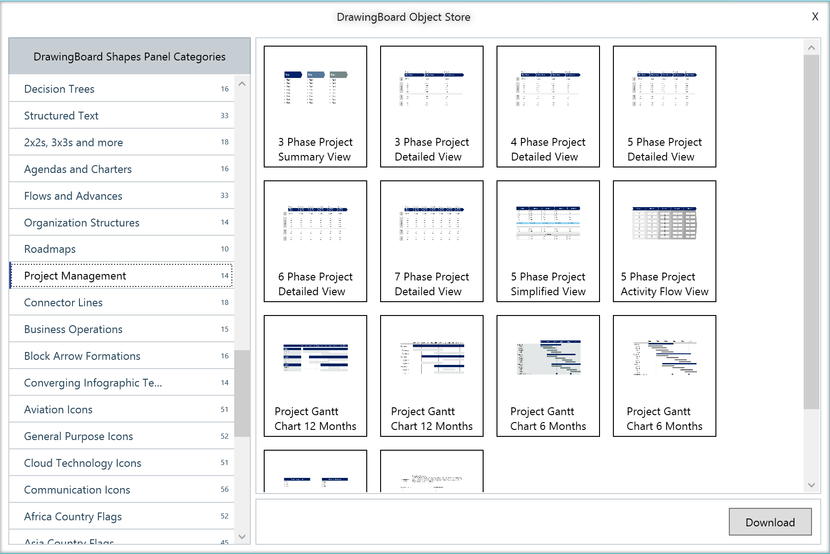
Choose from 100s of categories in Object Store
Dozens of icons related to various aspects of a project
Project Management
Download in 1 click
Watch Video: https://www.next2office.com/Tutorials.aspx

Slide 5
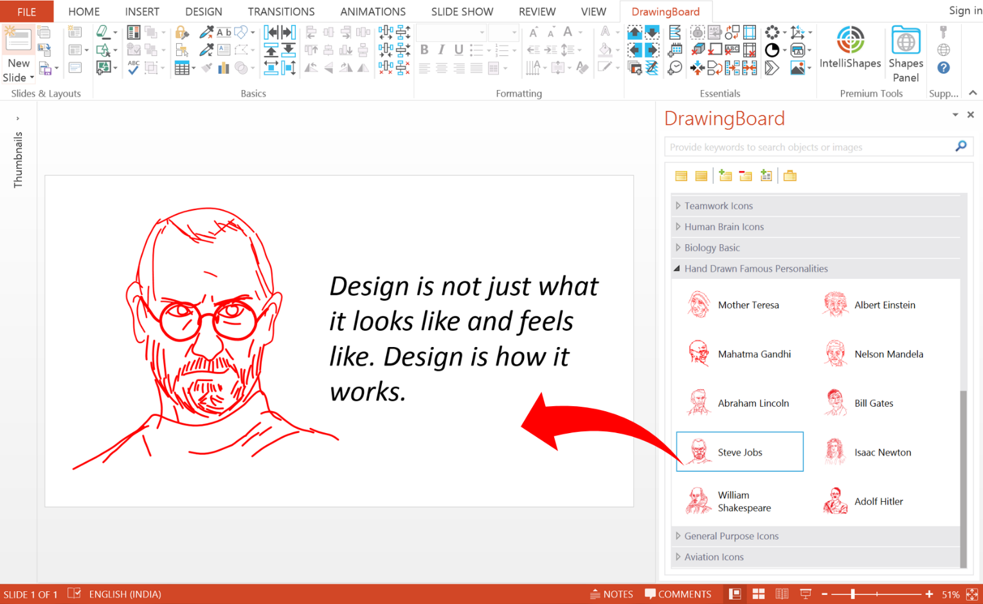
The power of DrawingBoard’s Shapes Panel
Smart Search Feature
Objects organized into category for meaningful classification
Objects displayed as icons with names and description
Drag and Drop action to insert the object into your slide
Watch Video: https://www.next2office.com/Tutorials.aspx

