Slide 1
DrawingBoard PPT Addin
Variations and Comparisons

Slide 2
Comparisons Basics
Product A
Product B
70%
40%

Slide 3
Variations of percentages
10%
10%
30%
60%
80%
20%
40%
70%
90%
25%
50%
75%
100%

Slide 4
Comparison of Items
10%
20%
60%
30%
40%
40%

Slide 5
Comparison of Items
10%
20%
30%
40%

Slide 6
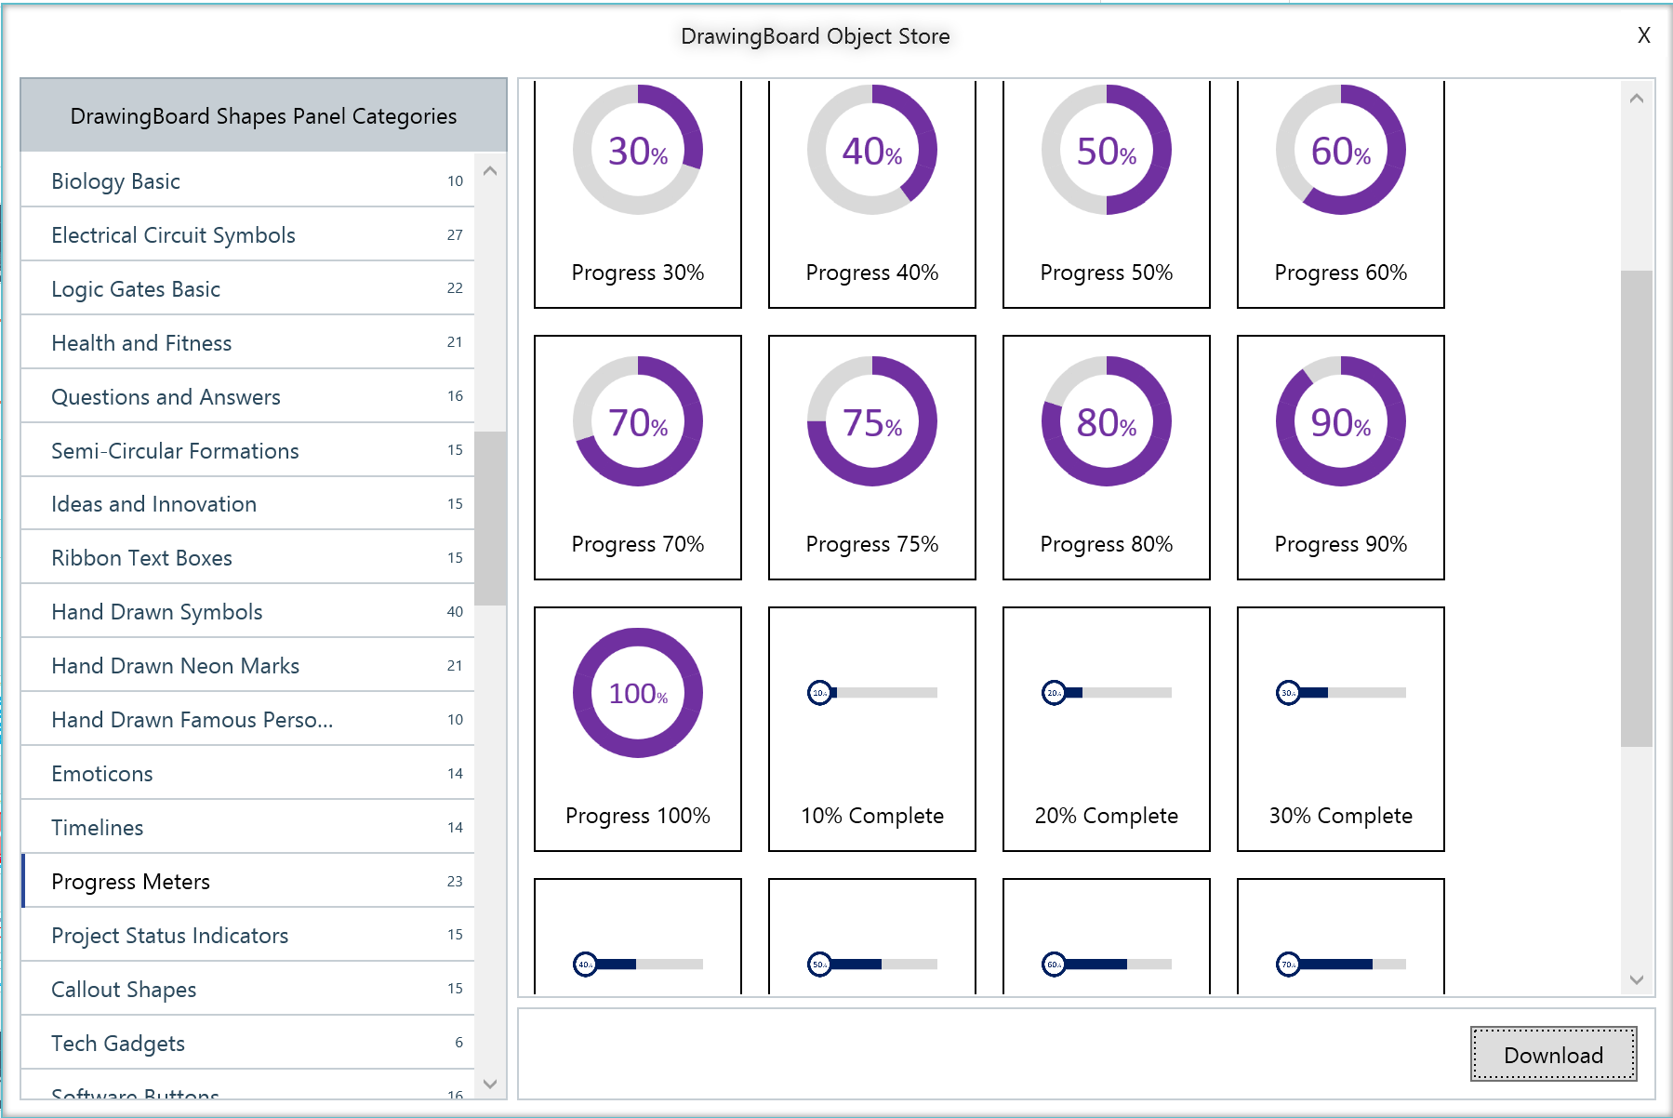
Choose from 100s of categories in Object Store
Dozens of Progress Meters
Progress Meters
Download in 1 click
Watch Video: https://www.next2office.com/Tutorials.aspx

Slide 7
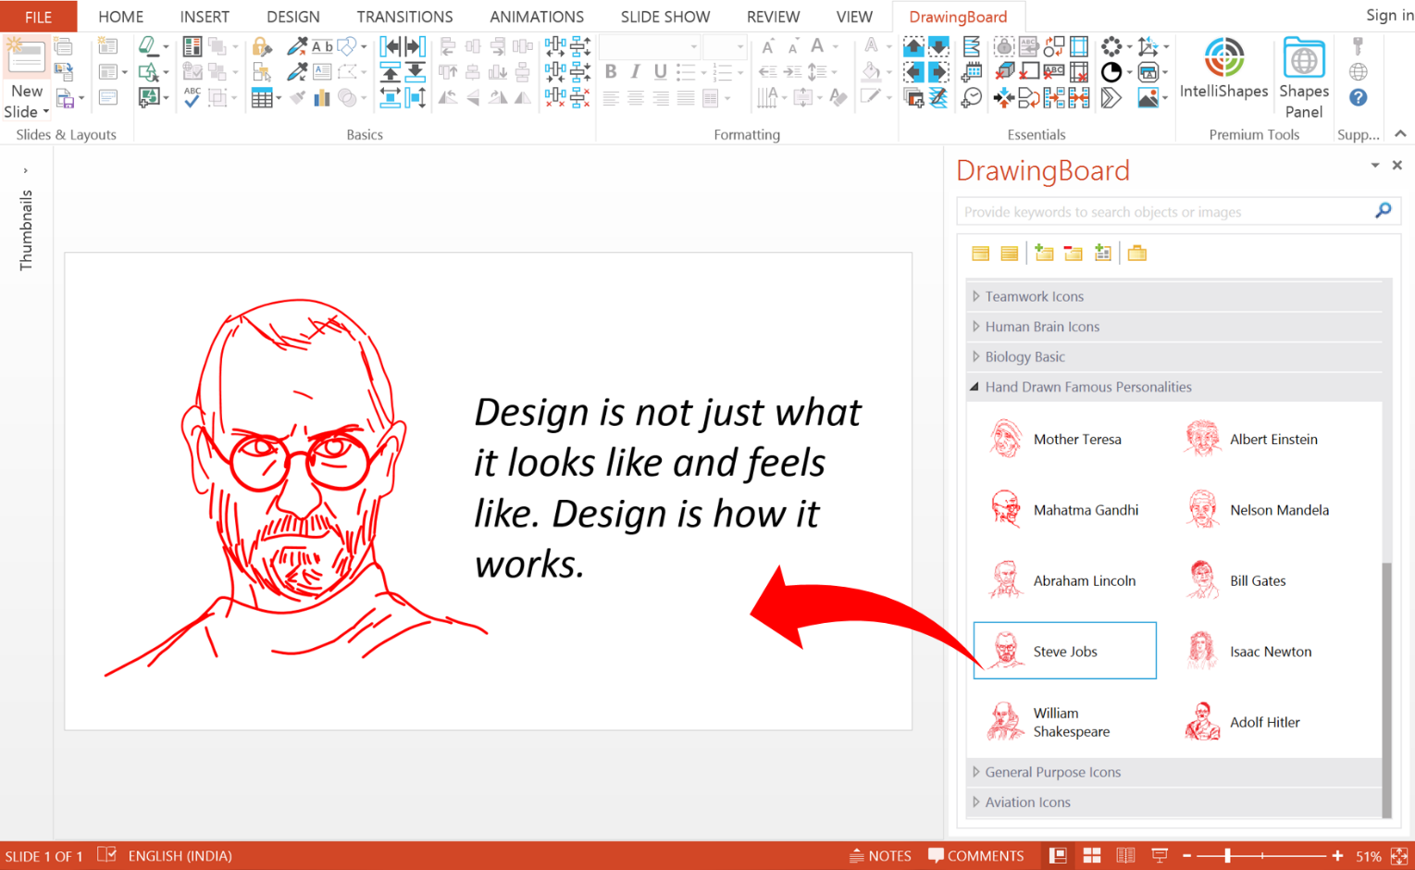
The power of DrawingBoard’s Shapes Panel
Smart Search Feature
Objects organized into category for meaningful classification
Objects displayed as icons with names and description
Drag and Drop action to insert the object into your slide
Watch Video: https://www.next2office.com/Tutorials.aspx

